Slide 1
SmartValve Support Monthly Service Report
March 2025
Version 1.0
Prepared for Severn Trent Water

Slide 2
Contents
Monthly Service Review
01 Management Summary
02 Performance
03 Risks and Issues
04 Action Log

Slide 3

01
Management Summary

Slide 4
Management Summary
 | Performance | Response & General Management | Stakeholder Management & Communications | Risk Management | Overall status
This Month
Last Month
Performance
Risk
Resourcing
Relationship
Performance:
The service has continued to be effectively delivered and has remained fully available during the month.
Performance (application & hosting) continues to be closely monitored, with weekly reports showing appropriate performance levels have been maintained
Response:
No concerns/issues were reported during the period.
Stakeholder Management & Communication:
Monthly service review meetings being held regularly. Weekly system reporting continued providing clear metrics and performance status.
Risk:
No new risks were identified during the period.
Overall:
The service has been successfully delivered and remained fully available throughout the month.
Application and hosting performance continue to be closely monitored, with weekly reports confirming that appropriate performance levels are being maintained.
Monthly service review meetings are conducted regularly, supported by weekly system reporting that provides clear metrics and performance updates.
The new .NET 8 web application (version 2025.02.8.17) has been deployed in the UAT environment. However, STW is encountering a few issues with this build. A new build provided by SV needs to be deployed in UAT for testing before further action.
During this period, the system and services have remained stable and reliable. However, as recommended by Microsoft, the Azure Functions apps must be upgraded to .NET 8 by November 12, 2024. Currently running on .NET 6, this upgrade is essential to maintain compatibility and performance.
SSL certificates in both the UAT and PROD environments have been successfully renewed, ensuring ongoing security and compliance.

Slide 5

02
Performance

Slide 6
Hosting Service
Service Coverage:
Hosting of the SmartValve Web App on Microsoft Azure.
24x7 availability of the SmartValve applications.
Resolution of hosting related incidents within agreed SLA.
Performance monitoring of the applications and scaling the infra resources accordingly.
Monitor and fix the infrastructure failures in Azure environment.
Manage certificates for DNS.
Configuration management of Azure environment.
Maintaining the testing (UAT) environment.
Application Availability
 |  | Oct’24 | Nov’24 | Dec’24 | Jan’24 | Feb’25 | Mar’25
Web App | Target availability (in hours)¹ | 744 | 720 | 744 | 744 | 672 | 744
 | Actual availability (in hours) | 744 | 720 | 744 | 744 | 672 | 744
 | % Availability | 100% | 100% | 100% | 100% | 100% | 100%
Mobile App | Target Availability (in hours) ¹ | 744 | 720 | 744 | 744 | 672 | 744
 | Actual availability (in hours) | 744 | 720 | 744 | 744 | 672 | 744
 | % Availability | 100% | 100% | 100% | 100% | 100% | 100%
SLA | SLA (met / breached) | Met | Met | Met | Met | Met | Met
Summary
Note¹ – Target availability = 24 hrs x number of days in the month

Slide 7
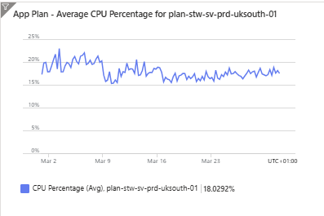
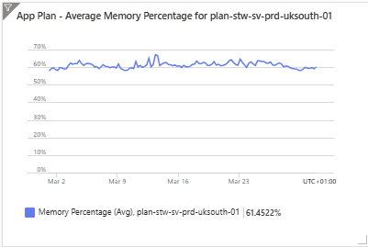
Hosting Service – Performance Metrics
Azure monitor is used to:
monitor the health, operation & performance of the applications.
setup alerts to notify critical conditions and automated / manual corrective actions based on triggers from metrics or logs
create visual metrics for monitoring / reporting purposes, weekly performance reports shared with the Severn Trent Water stakeholders
Performance during the month
Azure hosting remained healthy during the reporting period (no issues reported).
Performance metrics are for the period 1st March – 31st March 2025, taken directly from Azure and in 6 hrs granularity.
Expected range – 0 – 80 %
Expected range – 0 – 80 %

Slide 8
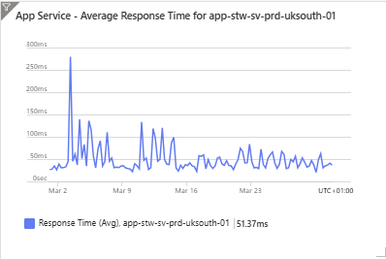
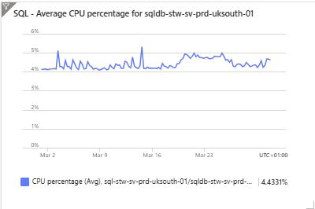
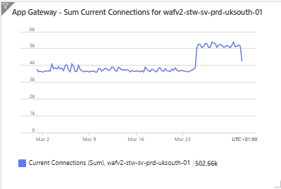
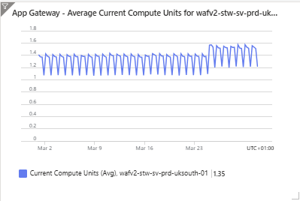
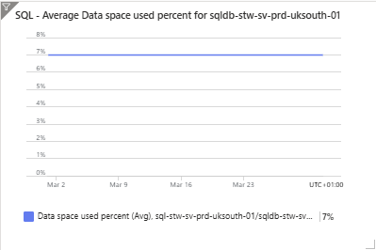
Hosting Service –Metrics (contd.)
Expected range – <5 seconds
Expected range – 0 – 80 %
Expected range – 0 – 80 %
Expected range – 0 – 80 %

Slide 9
Maintenance and Support Service– Incident Metrics
Service Coverage:
Providing 3rd level contact for STW SmartValve issues (via STW Service Desk)
Service hours – 9am – 5pm on business days
Incident management
Recording, monitoring and tracking of incidents (raised with Sopra Steria) to closure
Coordinating with SmartValve
Providing regular updates to STW
Service Level Agreement (SLA) management
Problem management
Change Management
Release / Deployment management
Escalations
High Impact Incidents
None
SLA Breached Incidents
None
Comments – None

Slide 10
Maintenance and Support Service – Release Management
App | Latest version on production | Production deployment date
Mobile | 3.0.5 | 22/08/2024
Web | 2024.1.16.14 | 17/01/2024
Release management activities during the month
App | Release version | Key contents | Date Available | Date deployed on UAT | UAT Completion | Prod Deployment | Status
web | 2024.11.8.17 | .Net 8 Upgrade | 11/21/2024 | 11/21/2024 | 11/21/2024 | Discussion are going on | Open
web | 3.0.15 | .Net 8 – Latest Upgrade with all Patches and Updates |  |  |  | Discussion are going on | Open

Slide 11
Maintenance and Support Service – UAT
No New UAT deployments in this month.

Slide 12
Maintenance and Support Service – Prod
No New PROD deployments in this month

Slide 13
Maintenance and Support Service - other key activities
Problem management
No problem records identified during the period.
Change Management
No Change Request/s required/progressed during the month.

Slide 14

03
Risks and issues

Slide 15
RAID
RISKS
Risk that mobile app issues might not be resolved within SLA because of dependency on Apple to get it published on App Store (SLA 24 hours, if approved). As recommended by Microsoft, Upgrade Azure Functions apps to .NET 8 by 12 November 2024, system and functions are running on .NET 6 so an update will be required to update the system and functions to .NET 8..
ASSUMPTIONS
None
ISSUES
Several reports are not running as expected and are causing the application to hang. SmartValve has provided a new build which is expected to fix this issue however due to the unavailability of resources to undertake UAT on this new build, STW has decided to put this on hold. No Options Available: When user is selecting a valve there are no options to Open/ close etc Search functionality isn’t working as expected in 3.0.5 UAT - Turn Data View: Unable to open Turn Data View after job completion, resulting in consistent errors for all test user IDs.
DEPENDENCIES
Dependencies on Microsoft might result in unavailability of application partially or completely. Dependencies on 3rd party, Apple on processing of new mobile app versions Dependency on STW availability to undertake UAT for any changes; release schedule to be agreed for each change.

Slide 16

04
Action Log

Slide 17
Action Log
Ref | Action / Updates | Owner | Target Closure Date | Status
1 | Align Prod / UAT | STW / SV / Sopra Steria | Closed | Closed
2 | New Build [2024.11.8.17] Has been deployed in UAT . | STW / Sopra Steria | Closed | Closed
3 | 2024.11.8.17 Web app build to be deployed in PROD | STW / SV / Sopra Steria | ASAP | OPEN

Slide 18
Thank You.
Text on several lines.

